Slide 1
Project Landscape
Data | Information | Knowledge
What percentage of the populations insurance data can we access? (i.e how many are insured?) What percentage of population own vehicles and property? What is the vehicle purchasing rate in the country? | What is the distribution of vehicle incidents today based on the data across the different states? How are we collecting and using this data? What other factors could influence vehicle incidents? | What claims data is available? What are other companies insurance premiums

Slide 2
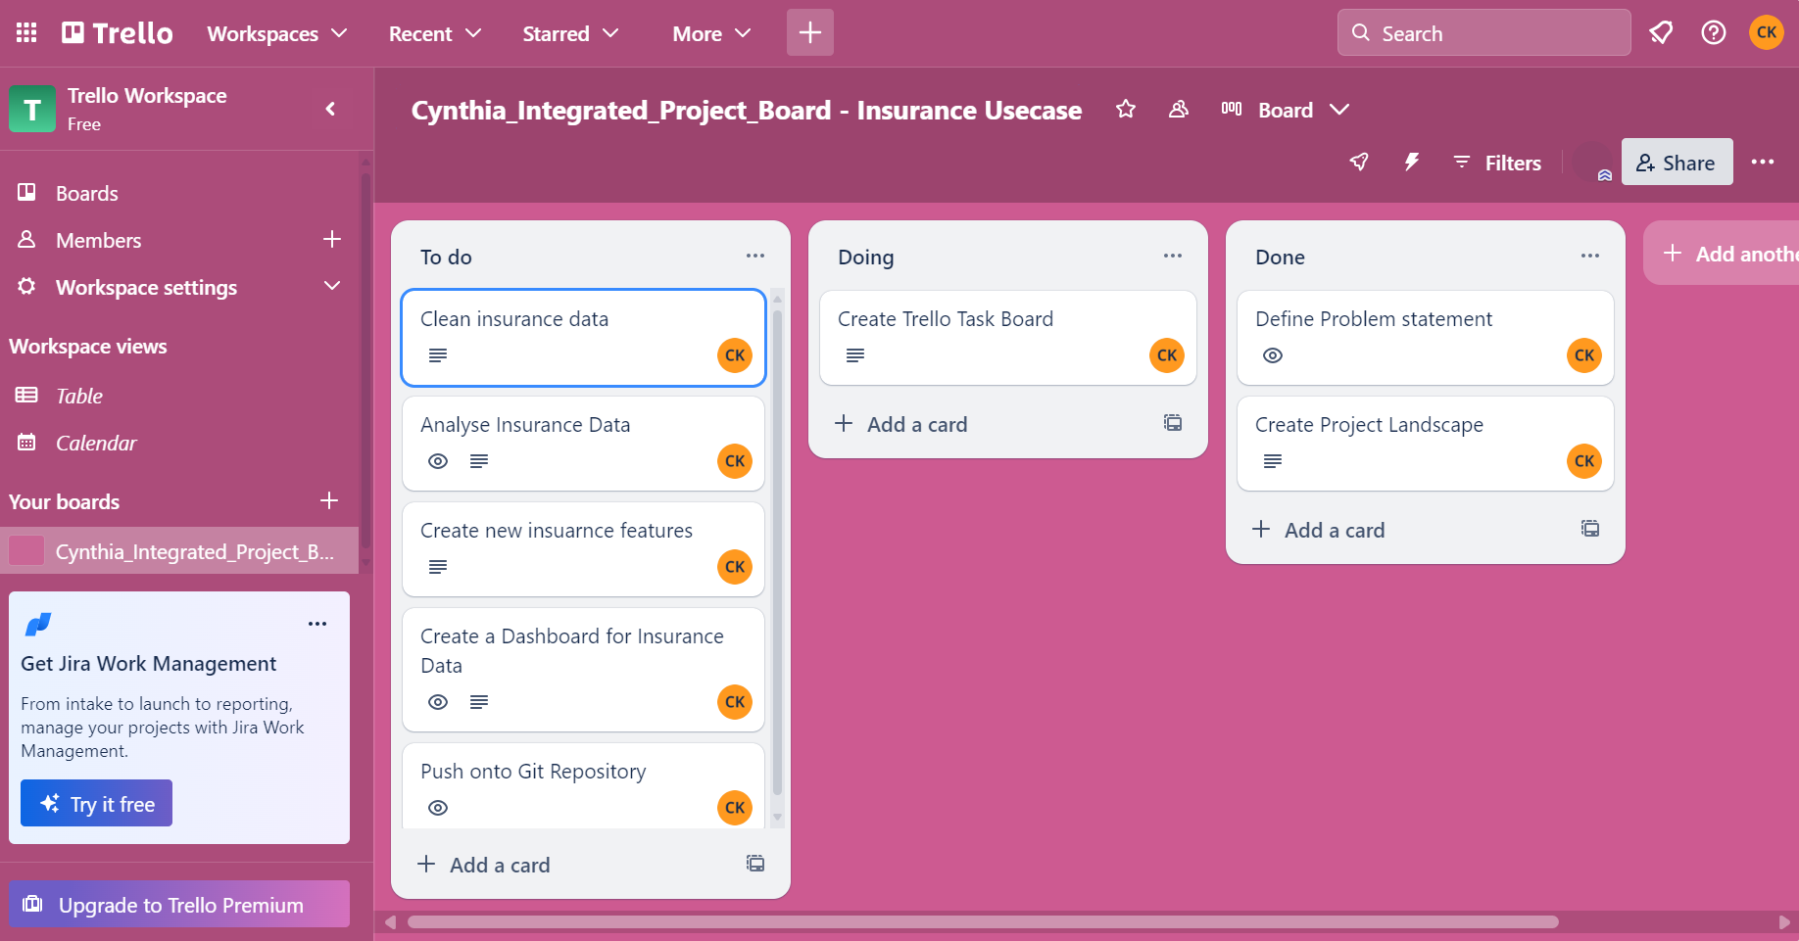
Project Planning

